Slide 1


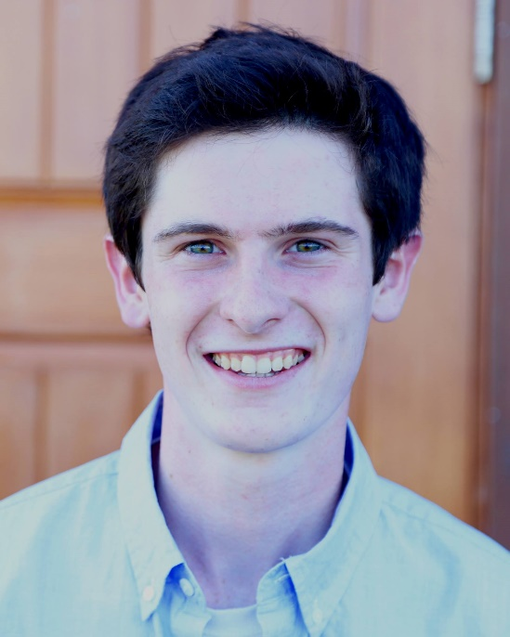
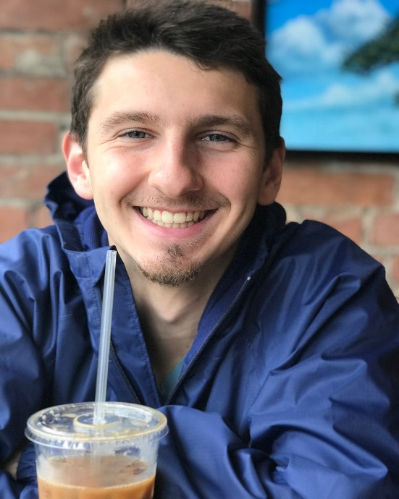
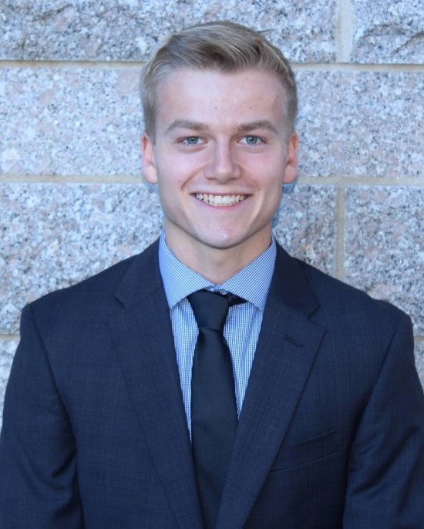
UNH SEDS
The Hungriest Engineers
Summer 2019
Ben Letourneau
Lucas Simmonds
Thomas Collins
Ben joined the team just a couple weeks before summer break, but was a superstar that assisted the team to get all flow and ignition systems working reliably for the hot-fire in mid-August
Not only did Lucas learn the entire flow and ignition system from the mechanical system to the Arduino code, he reworked and optimized the work from last year. He stepped up and lead the group to the most successful hot-fire we could have had. He was definitely hungry.
Although working like crazy over the summer at Turbocam as a manufacturing engineer, Thomas spent long nights in the SEDS shop making sure all our supporting systems during the test will collect reliable and precise (enough) data. He also took on coordinating the logistics of most of the engineering and testing operations of the summer!

